Slide 1

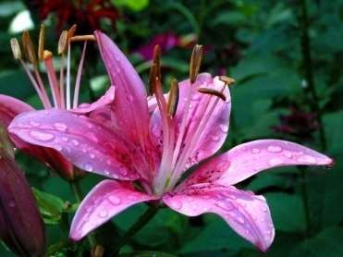
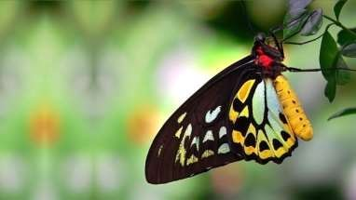

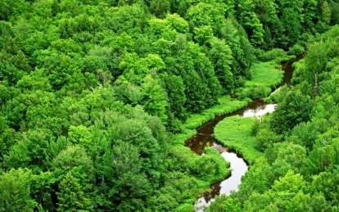
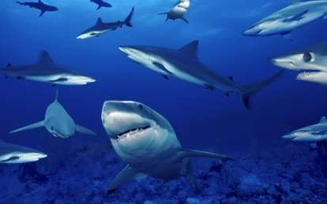
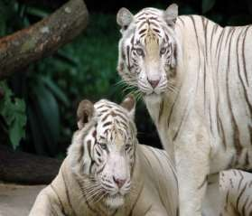
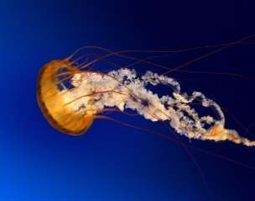








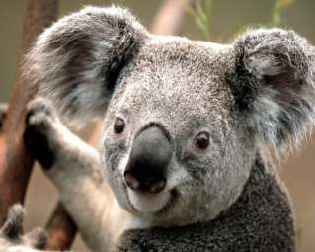
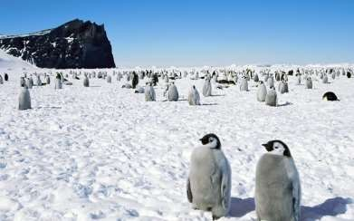
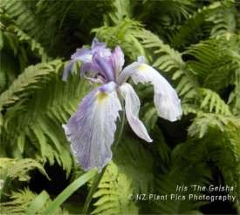

Slide 2

Introduction
The term Biodiversity was first coined by Walter G. Rosen in 1986.
The biosphere comprises of a complex collections of innumerable organisms, known as the Biodiversity, which constitute the vital life support for survival of human race.
Biological diversity, abbreviated as biodiversity, represent the sum total of various life forms such as unicellular fungi, protozoa, bacteria, and multi cellular organisms such as plants, fishes, and mammals at various biological levels including, habitats, and ecosystem .

Slide 3

Concept of Biodiversity & its Types
Biodiversity is the variety of life on Earth.
For any kind of animal or plant – each individual is not exactly the same as any other; nor are species or ecosystems.
Biodiversity is generally described at three levels: genetic diversity, species diversity and ecosystem diversity.

Slide 4

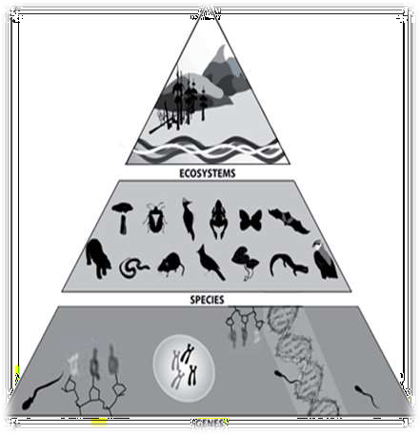
Types of Biodiversity
There are three types of biodiversity:-
Genetic Biodiversity
Species Biodiversity
Ecosystem Biodiversity

Slide 5
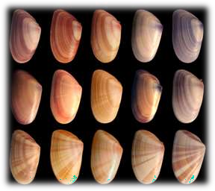
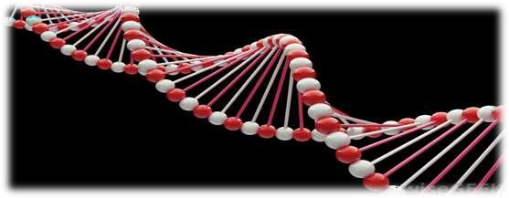
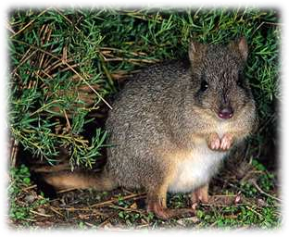
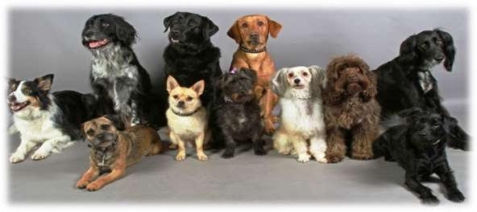
Genetic Biodiversity

Slide 6
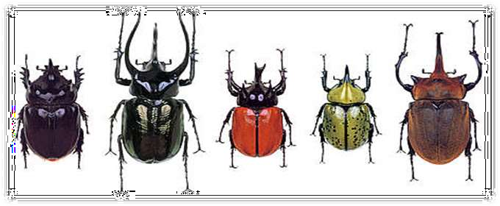
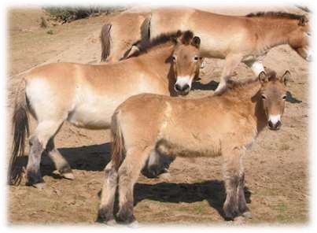
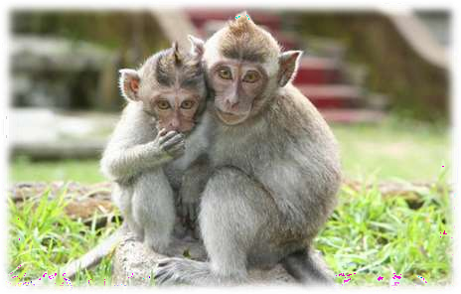
Species Biodiversity

Slide 7
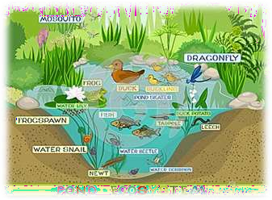
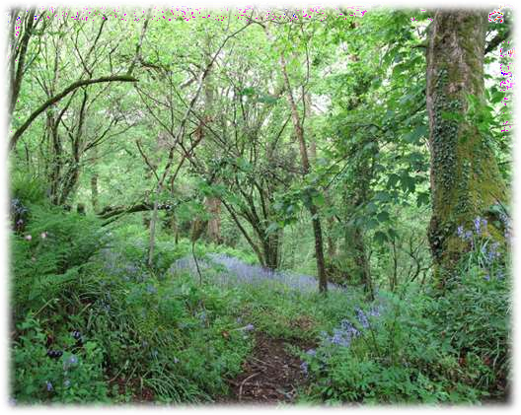
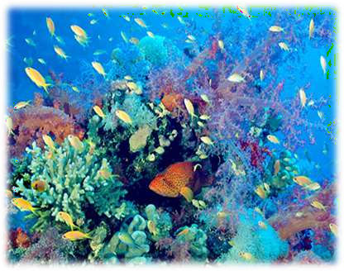
Ecosystem Biodiversity

Slide 8
Ecosystem or Habitat Biodiversity
Ecosystem is the structural and the functional unit of the biosphere.
Ecosystem diversity is defined as,“ the aggregation of various habitats, community types and abiotic environment in a given area.”
India has one of the biggest ecosystem diversity, ranging from the deserts, plains, hills, mangroves, rainforests to cold Himalayas.

Slide 9
Distribution of Biodiversity
Biodiversity is not evenly distributed, rather it varies greatly across the globe as well as within regions.
Terrestrial biodiversity is thought to be up to 25 times greater than ocean biodiversity.
The study of the spatial distribution
of organisms, species and ecosystem, is the science of biogeography.

Slide 10
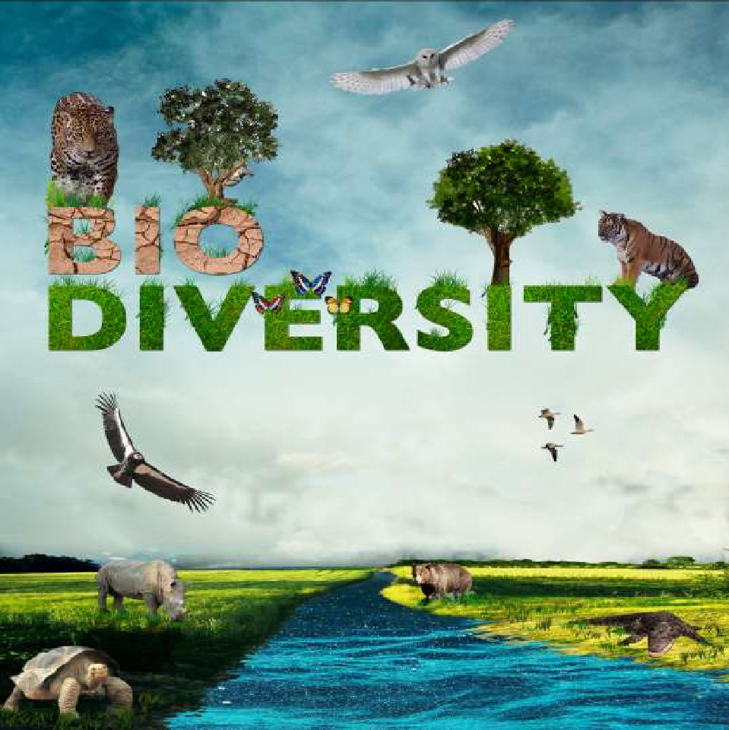
AND THREATS TO IT….

Slide 11

Threats to Biodiversity
Habitat Destruction- Important to protect habitat in order to protect biodiversity within it. Huge pressure from the World’s rapidly increasing population.
Global Climate Change- Change in a biotic elements of ecosystems leading to biotic change.
Habitat Fragmentation- From human activity. Reduces ability of habitat to support species.
Pollution- Introduction of pollutants such as nutrient overloading with nitrate fertilizer as well as more immediately harmful chemicals.
Over-Exploitation- This includes the illegal wildlife trade as well as overfishing, logging of tropical hardwoods etc.
Alien Species- Introduced by humans to regions where there are no natural predators.
Disease- Reduction in habitat causing high population densities, encourages spread of diseases.

Slide 12
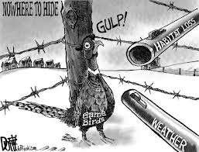
Habitat loss

Slide 13
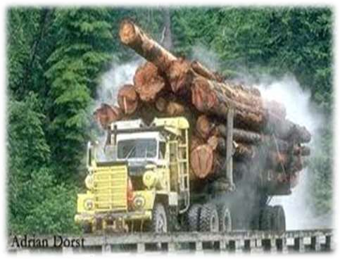
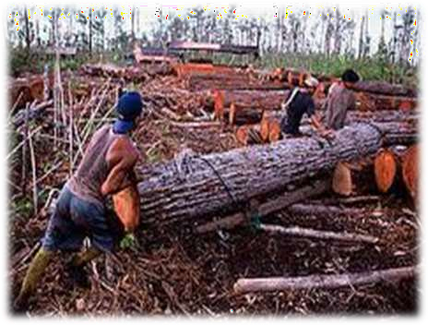
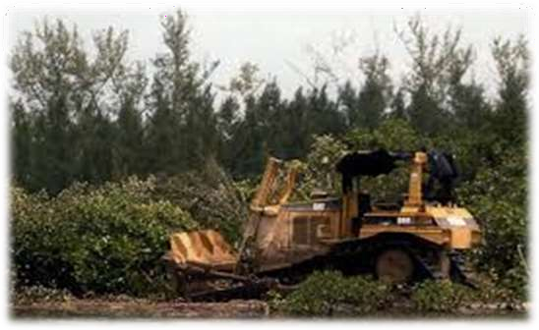
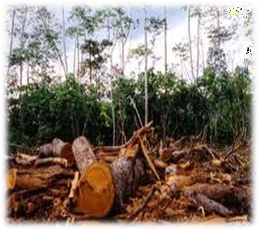

Slide 14
Habitat loss:-
Habitat loss can be described when an animal loses their home. Every animal in the animal kingdom has a niche, a their in their animal community and without their habitat they no longer have a niche.
Reasons of habitat loss by humans:
~ agriculture, farming
~ harvesting natural resources for personal use
~ for industrial and urbanization development
Habitat destruction is currently ranked as the primary causes of species extinction world wide…!!!

Slide 15
Example :
The impact upon china’s panda, ones found across the nation. Now it’s only found in fragmented and isolated regions in the south west of the country as a result of wide spread deforestation in the 20th century.
There are natural causes too..
Habitat destruction through natural processes such as volcanism, fire and climate change is well documented in the fossil record. One study shows that fragmentation of tropical rainforest in euro 3000 million years ago lead to a great loss of amphibian diversity.

Slide 16
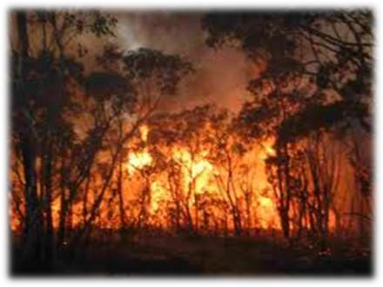
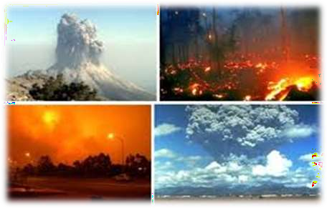
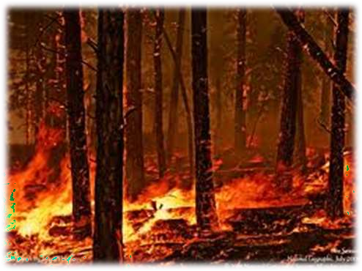
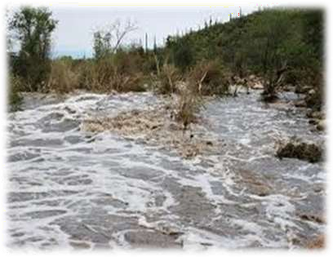

Slide 17
Solutions on for this..
~ Protecting remaining intact section of natural habitat.
~ Reduce human population and expansion of urbanisation and industries.
~ Educating the public about the importance of natural habitat and bio diversity.
~Solutions to habitat loss can include planting trees, planting home gardens so as to reduce need for man to need large lands for agricultural farms which lead to habitat loss.

Slide 18
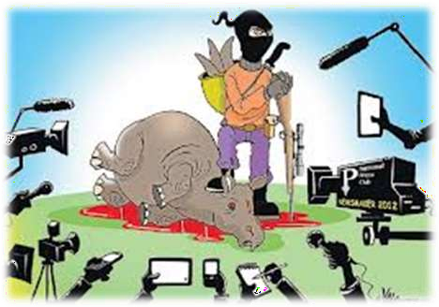
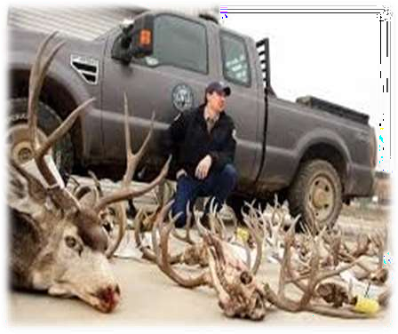

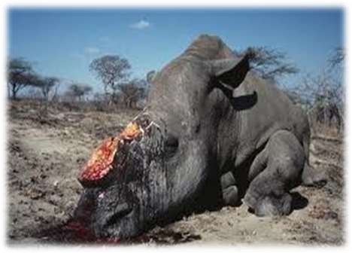
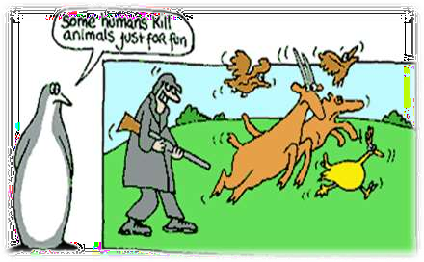
Poaching

Slide 19
Poaching:-
Poaching is the hunting and harvesting taking of wild plants or animals, such as
through hunting, harvesting, fishing, or trapping.
History of poaching
~ Millions of years ago, in the Stone Age
~Followed through the ages, to even the tribal natives
~but it was during the Late Middle Ages that poaching became a punishable offense

Slide 20
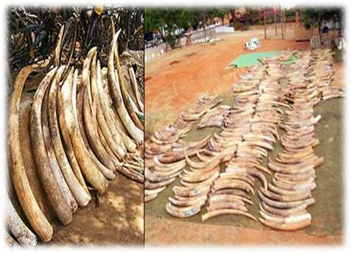
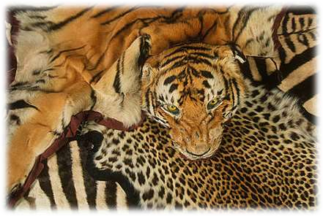
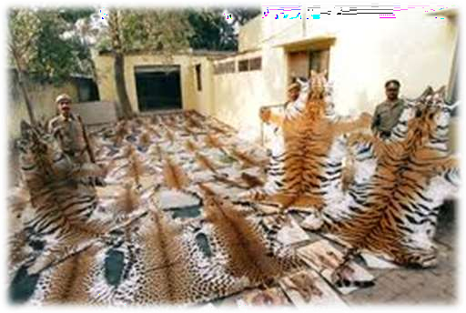
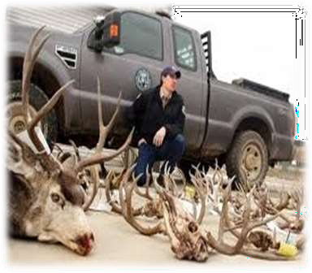

Slide 21
Why Poaching is done???
~ Poaching is done for large profits gained by the illegal sale or trade of animal parts, meat and pelts.
~ Exists because there is a demand for these products, caused by a lack of education or disregard for the law amongst the buyers.
~ Many cultures believe that certain animal parts have medicinal value.

Slide 22
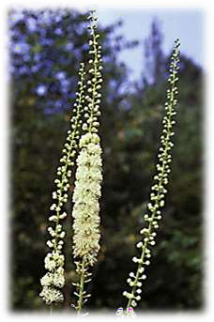
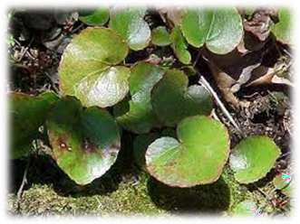
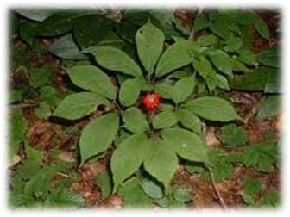
Poaching is not limited to animals its also for plants too…………!
Three of the most often poached species in the park are galax, black cohosh, and ginseng.
GALAX
BLACK COHOSH
GINSENG

Slide 23
How does poaching affect the environment?
~Poaching or illegal hunting causes animals endangered of being extinct. If more animals becomes extinct there's
a disruption in the food chain, and that will cause major problems in our ecosystem, resulting eventually in new adaptations of animals, and or species beyond human control.
~Poaching results in animals being hunted too soon for them to have time to reproduce and repopulate.

Slide 24

Recent Issue on Biodiversity
Some 75% of the genetic diversity of crop plants been lost in the past century.
Some scientists estimate that as many as 3 species per hour are going extinct and 20,000 extinctions occur each year.
Roughly one-third of the world’s coral reef systems have been destroyed or highly degraded.
About 24% of mammals and 12% of bird species are currently considered to be globally threatened.
More than 50%of the world’s wetlands have been drained, and populations of inland water and wetland species have declined by 50% between 1970 and 1999.

Slide 25
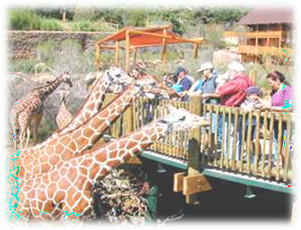
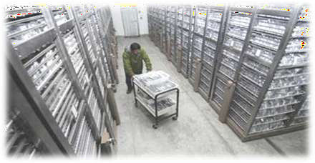
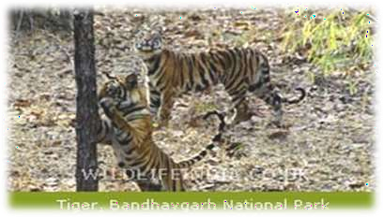
Conservation of Biodiversity
Restoration of Biodiversity
Imparting Environmental Education
Enacting, strengthening and enforcing Environmental Legislation
Population Control
Reviewing the agriculture practice
Controlling Urbanization
Conservation through Biotechnology

Slide 26
Biodiversity in India
Categories No. of Indian % of Indian Species Species Threatened Species Evaluated in India
Mammals 386 59 41%
Birds 1219 - 7%
Reptiles 495 73 46%
Amphibians 207 79 57%
Freshwater Fish 700 46 70%

Slide 27
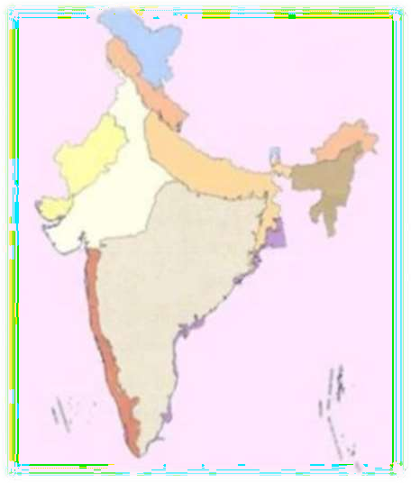


The Ten Biography Regions of India
The Trans-Himalayan
The Himalayan
The Indian Desert
Semi-arid Zone
Western Ghats
Deccan Peninsula
The Gangetic Plain
North East India
The Islands
The Coasts

Slide 28
India figured with two hotspots- The Western Ghats & The Eastern Himalayas in an
identification of 25 of the world’s biological
richest and most threatened ecosystem
These two hotspots that extends to India are
The western Ghats/Sri Lanka
The Indo-Burma region ( covering the Eastern Himalayas)
And they are included amongst the top eight most important hotspots.
The are the areas with higher concentration of endemic species and which usually experience rapid rate of habitat modification and loss.

Slide 29

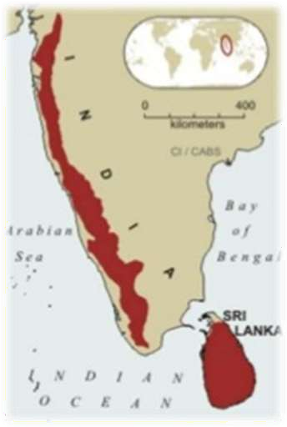
Western Ghats
Western Ghats faced with tremendous population pressure the forests of western Ghats and Sri lanka have been dramatically impacted by demands for agriculture and Timber.
The region is home to rich endemic assemblage of plants, reptiles and amphibians as well as elephants, tiger and endangered lion tailed Macaque.

Slide 30
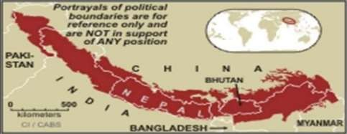
The Eastern Himalayas
Himalayas is the home to world’s highest mountains, including Mt. Everest. Abrupt rise in rise of mountains results in diversity of ecosystems that range from alluvial grasslands and subtropical broad leaved forests to alpine meadows above the tree line. It’s a home to variety of large birds, mammals including tiger, elephants, rhinos and wild water buffaloes.

Slide 31
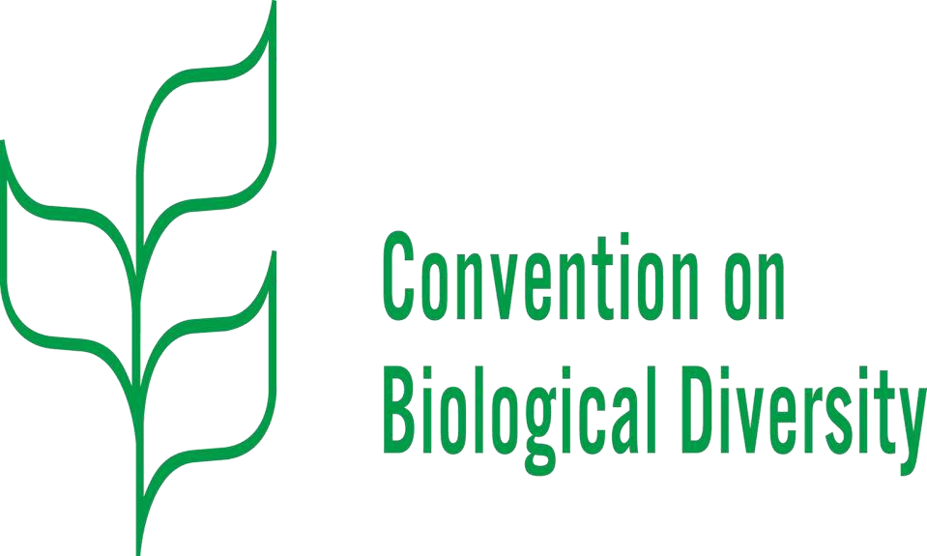
Convention on biodiversity
The Convention on Biological Diversity (CBD), known informally as the Biodiversity Convention, is a multilateral treaty. The Convention has three main goals:
conservation of biological diversity (or biodiversity);
sustainable use of its components; and
fair and equitable sharing of benefits arising from genetic resources

Slide 32
Conclusion
Biodiversity is a concept that has no general definition. Usually it is used in a context that stresses the need for attention on our living environment and the sustainable use of natural resources.
Biodiversity can be divided in different types such as habitat, species and genetic diversity.
The integrated approach used in coastal zone management is an adequate method in dealing with the matter of biodiversity.

